Slide 1



Diagnostic Analysis of Heart Disease Using Power BI Desktop
This presentation offers a comprehensive analysis of heart disease diagnostics leveraging the capabilities of Power BI Desktop. We will explore key physiological factors that influence cardiovascular health, including blood pressure, cholesterol levels, and age. These insights aim to empower healthcare professionals with a deeper understanding of heart disease risk factors, enabling more informed and personalized patient care.

Slide 2
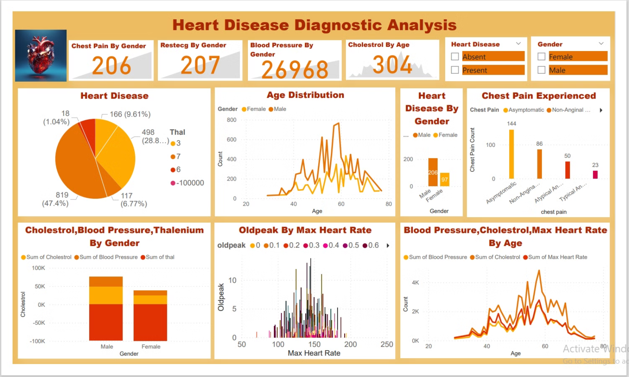

Slide 3
Blood Pressure By Gender
Blood Pressure Distribution
Interpreting the Data
Implications for Healthcare
This visualization showcases the distribution of blood pressure among males and females. The average blood pressure for males is slightly higher than for females. However, it's essential to note that individual variations exist within each gender group.
Elevated blood pressure is a significant risk factor for heart disease. Analyzing blood pressure data by gender can help identify potential disparities and guide personalized preventive measures.
Understanding gender-based differences in blood pressure can help healthcare providers tailor interventions and treatment plans to address specific needs. This data can also be used to advocate for targeted public health initiatives.

Slide 4
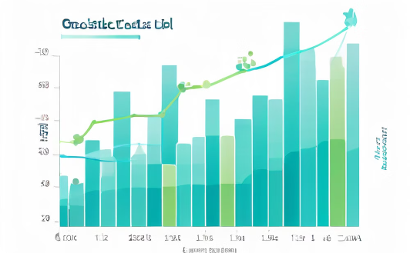


Age-Related Cholesterol Trends
Understanding the Impact
Implications for Patient Management
This visualization illustrates how cholesterol levels change with age. The data reveals a general upward trend in cholesterol levels as individuals age, particularly after the age of 30.
Elevated cholesterol is a key contributor to heart disease. Understanding the link between age and cholesterol levels is crucial for preventive care and early intervention.
This data can help healthcare professionals identify individuals at higher risk for elevated cholesterol based on their age. Early screening and lifestyle modifications can play a significant role in mitigating the risk of heart disease.

Slide 5

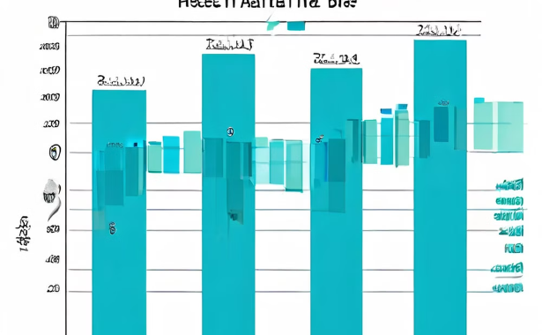

Heart Disease Prevalence by Gender
Gender Disparities
The data shows that while 304 females have heart disease, the number is 206 for males. However, the percentage of males affected is significantly higher, emphasizing the need for targeted prevention and intervention strategies.
This visualization highlights the gender-based differences in heart disease cases. While the overall number of female patients with heart disease is higher, the percentage of affected males is significantly greater, indicating a higher risk for men.

Slide 6


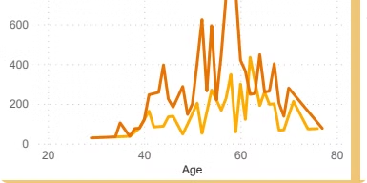


Cholesterol, Blood Pressure, and Thalenium by Gender
Cholesterol Levels
The average cholesterol levels for males are higher than for females. This observation aligns with the established link between cholesterol and heart disease risk.
Blood Pressure Variations
Blood pressure readings also show a slight difference between genders, with males exhibiting higher average blood pressure. This reinforces the importance of gender-specific risk assessment for heart disease.
Thalenium Levels
Thalenium, a marker of blood flow, shows a noticeable difference between genders. While the average thalenium level is slightly lower for females, further research is needed to fully understand the implications for heart health.

Slide 7

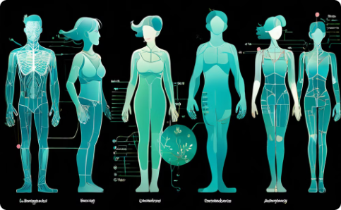

Age Distribution and Heart Disease
Age as a Risk Factor
Understanding the Dynamics
Implications for Public Health
This visualization demonstrates the clear relationship between age and the risk of heart disease. As individuals age, the prevalence of heart disease increases.
With age, physiological changes occur in the body, potentially leading to increased susceptibility to heart disease. This underscores the need for age-appropriate preventive measures.
This data highlights the importance of public health initiatives targeting older adults to promote heart-healthy behaviors and early detection of heart disease.

Slide 8
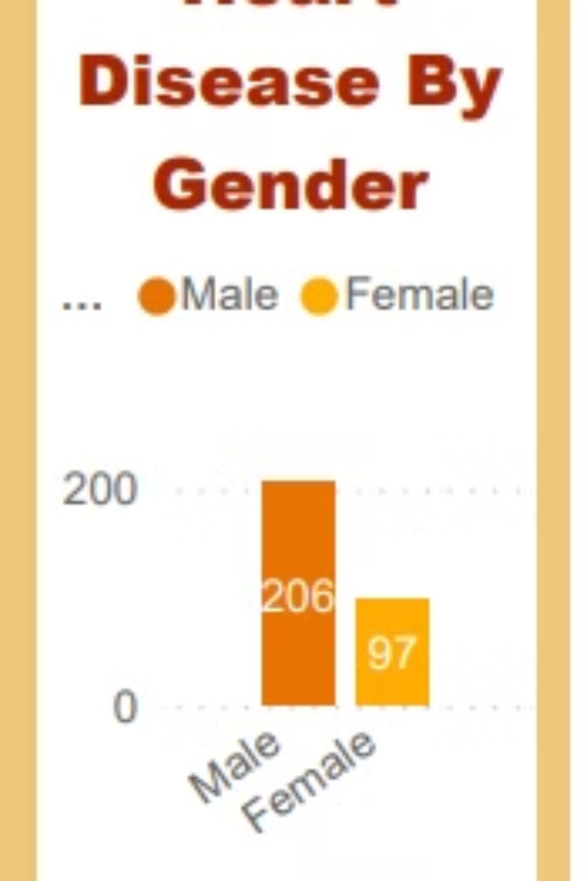



Max Heart Rate and Heart Disease
Max Heart Rate Trends
This visualization reveals a trend between heart disease and maximum heart rate. Individuals with lower maximum heart rate are more likely to have heart disease.
Understanding the Connection
A lower maximum heart rate could indicate underlying cardiovascular issues that increase the risk of heart disease. It's a crucial indicator for heart health assessment.
Clinical Implications
Measuring maximum heart rate can be a valuable tool for identifying individuals at higher risk of heart disease, facilitating early intervention and preventive strategies.

Slide 9

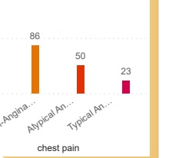
Chest Pain and Heart Disease
Chest Pain as a Symptom
Chest pain is a common symptom associated with heart disease. Analyzing the frequency of chest pain experienced by individuals with and without heart disease provides valuable insights into its diagnostic significance.
Prevalence by Chest Pain Type
The data shows that the prevalence of heart disease is higher among individuals experiencing specific types of chest pain, such as non-anginal pain. This suggests a correlation between certain types of chest pain and heart disease.
Clinical Applications
These findings can guide healthcare professionals in evaluating chest pain complaints. The presence of specific chest pain types may warrant further investigation to assess the risk of heart disease.

Slide 10
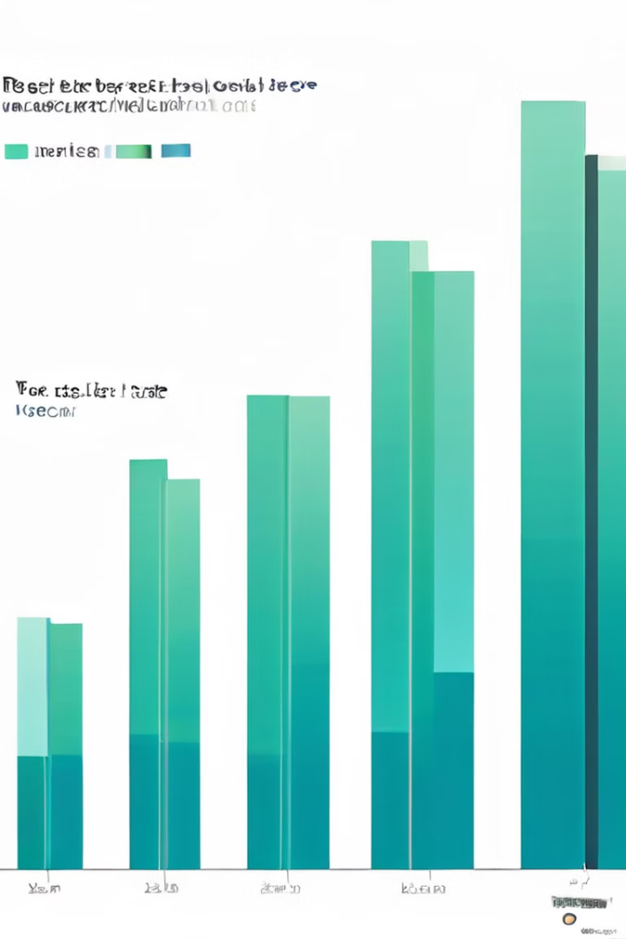
Restecg and Heart Disease
This visualization explores the relationship between Restecg (Resting Electrocardiographic Measurement) values and heart disease. The data indicates that individuals with heart disease tend to have a different distribution of Restecg values compared to those without heart disease. This suggests that Restecg can be a valuable tool for detecting heart disease.

Slide 11

Conclusion
This analysis has provided valuable insights into the factors that contribute to heart disease risk. Using Power BI Desktop, we have explored the impact of gender, age, blood pressure, cholesterol levels, maximum heart rate, chest pain, and Restecg on heart health. These findings emphasize the importance of comprehensive diagnostics and personalized care for preventing and managing heart disease. By leveraging data-driven insights, healthcare professionals can make more informed decisions, promoting better patient outcomes and advancing the field of cardiovascular health.

Slide 12
Thank You !

